Slide 1

Research Fab Microelectronics Germany (FMD)
  —
      Fraunhofer Group for Microelectronics in cooperation with the Leibniz institutes IHP and FBH
Seite 1
02.06.2023
Dr. Daniela Hübler, Manager Innovation and Startups

Slide 2


Slide 3
greenict.space
The Accelerator for sustainable Startups und SMEs

Slide 4


Green ICT @ FMD
greenict.space – The Accelerator for sustainable Startups and SMEs
What is the greenict.space about?
Accompanies and promotes product ideas to develop them in an environmentally friendly and resource-saving manner
Offers the necessary support for the technological challenges in the area of Green ICT
Promotes exchange and cooperation through networking
Target Group:
Our services:
Development Goal:
Incentive:
Bringing together complementary competencies from multiple FMD-Institutes
Use of clean rooms and over 2200 machines and equipment of the Competence Center Green ICT @ FMD
Demonstrators
Prototypes
Pilot manufacturing
Funding up to € 250,000 for participating FMD partners
For a project duration of
up to one year
Startups
SMEs
Notes:
Start-ups und Gründer werden über die Ausschreibung, Messen und Events gescoutet.
Anschließend erfolgt das Matching mit Experten der FMD, ob Kriterien der Ausschreibung und Machbarkeit erfüllt sind
In einem Workshop sollen Start-ups und Gründer zusammen mit den in Frage kommenden Instituten ihr Vorhaben in Form eines Projektsteckbriefs konkretisieren und eine Kalkulation aufstellen.
Es erfolgt ein Pitch vor einer Jury, die das Zusammenspiel von Gründerteam, dem Technologie-Reifegrad und dem Potential bewertet.
Insgesamt 6 Start-ups können innerhalb des Green ICT Projekts aufgenommen und indirekt über die Prototypherstellung gefördert werden.

Slide 5
Green ICT @ FMD
greenict.space – The Accelerator for sustainable Startups and SMEs
Application and selection process
At least two of the following five criteria must be proven to be the focus of the business activity.
Criteria:
Reduction of the CO₂ footprint
Hardware ecodesign
Sustainable digitalization
Sustainable business model
Sustainable consumption
Apply now until July 30, 2023!
Online using this web form: https://greenict.de/startups/
A total of 3 application and selection
rounds are planned until the end of 2024
Notes:
Laufzeit: 31.01.2026
Budget: 1,5 Mio €

Slide 6
Green ICT @ FMD
greenict.space – The Accelerator for sustainable Startups and SMEs
31.05.
Start of the first
application round
on Green ICT website
30.07.
Application deadline
June
July
August
September
October
November
December
…
Matchmaking
Initial consultation with FMD experts
Contacting the matching Green ICT institutes
Project launch
End of October
Selection process
Jury pitch
Jury meeting
Selection of the Startups & SMEs
Workshop
Preparation of the project application
Negotiating the cooperation agreement
Preparation of the jury pitch

Slide 7
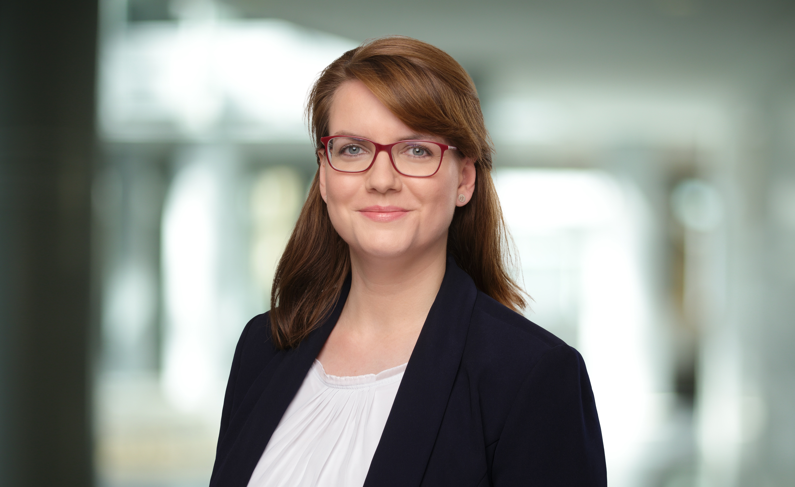
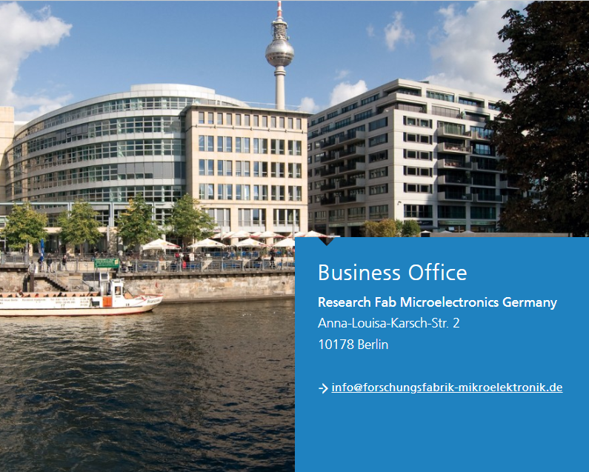
Thanks for your attention!
Contact
    Dr. Daniela Hübler
    Manager
    Innovation and Startups
    +49 151 7261 9479 space@mikroelektronik.fraunhofer.de

